Slide 1
Oindrila Das
Singer
&
Live Performer

Slide 2
Musical Journey
Hold the Runner up Trophy in ETV Bangla ‘TARANA’ in the year 2006
Hold 4th position in Zee Bangla ‘Sa Re Ga Ma Pa Little Star’ in the year 2007
Hold the Runner Up Trophy in ‘Colgate Antakshari’ in Star Plus, Mumbai in the year 2008
Hold 6th position in Zee Bangla
‘Sa Re Ga Ma Pa Biswasera’ in the year 2009

Slide 3
Hold Third position in ‘Bengal Music League’ in E TV Bangla in the year 2010
Contestant of Zee TV Saregamapa ‘Singing Superstar’ in the year 2010
Contestant of Zee TV Saregamapa 2012 Winner of The Telegraph In Schools (TTIS) Award as the best singer.
Have been a regular performer in ‘Take A Break Live’ in Tara Music.
Performed twice in ‘Good Morning Akash(Live)’ in Akash bangla Channel

Slide 4
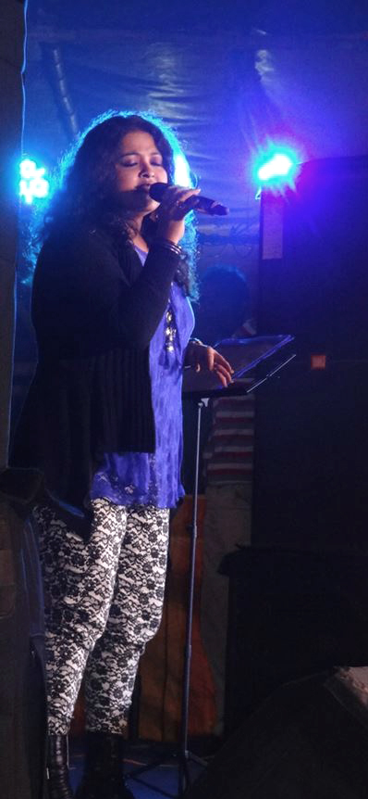
A Step Ahead
Oindrila puts herself further by stepping into the Bengali playback scenario lending her voice for the Bengali Movie “Prem By Chance”
Choi Choi Choi (Subhamita,Oindrila,Rupankar)
Music- Rupankar
link-http://www.youtube.com/watch?v=mLhqk1VNSRA
Lotke Debo Sotke Debo (Protik,Oindrila,Shilajit)
Music- Rupankar
Link-https://www.youtube.com/watch?v=2y0gYWCJRdw

Slide 5
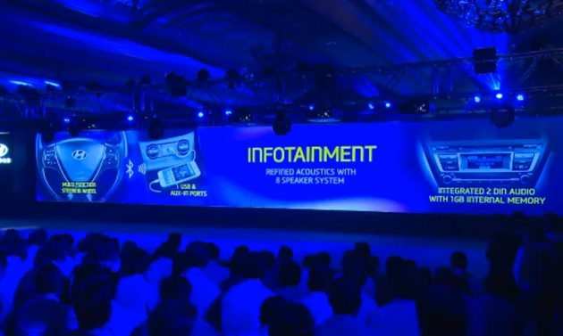
A prolific Performer & Livewire on Stage
Has done shows for colleges all over the country including top Institutions like XLRI,ISB, MITS, XIMB,
Vidyasagar University, and many more.
Have performed for corporate events like Aveda Chariot,
Hyundai Promo launch, Volkswagen and many more.

Slide 6
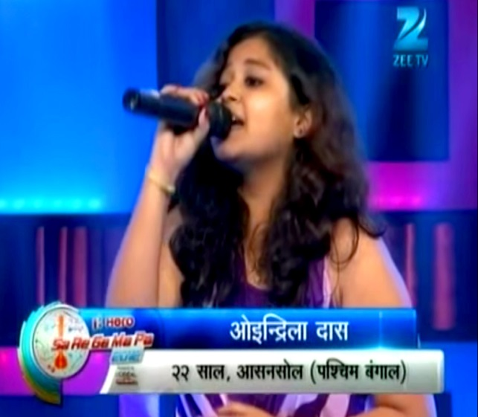
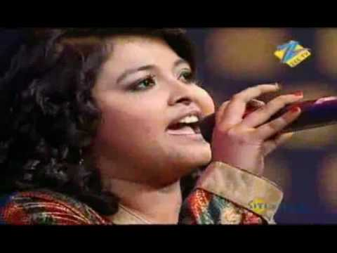
Sa Re Ga Ma Pa Singing Superstar 2010 show reel
Link:
https://www.youtube.com/watch?v=mrqzFsGQn2g

Slide 7
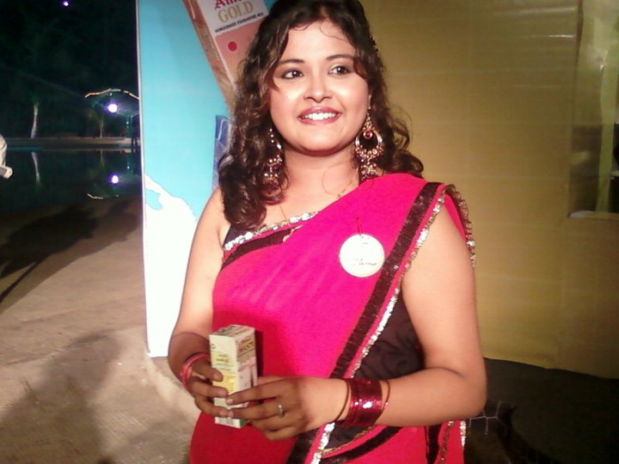
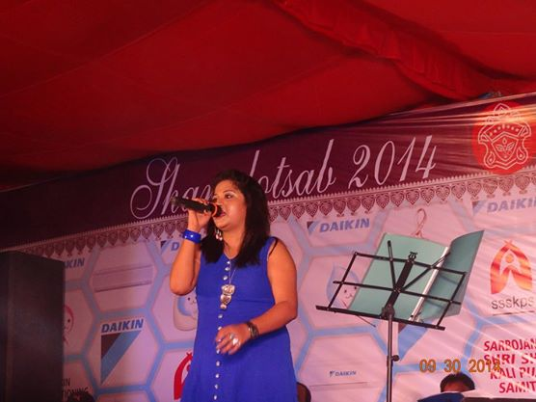
Some Glimpses

Slide 8
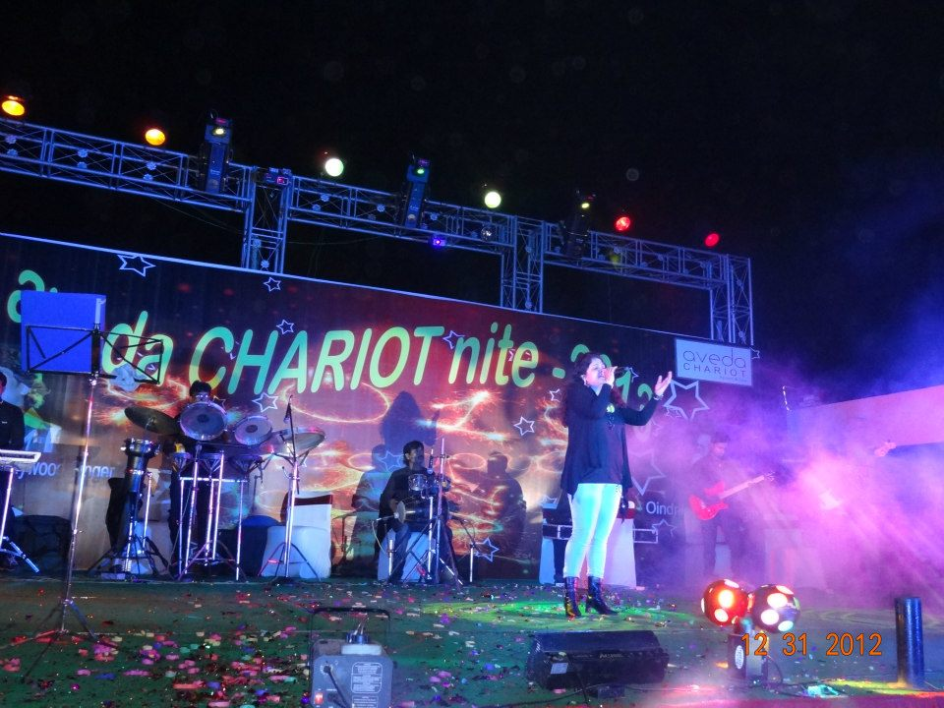
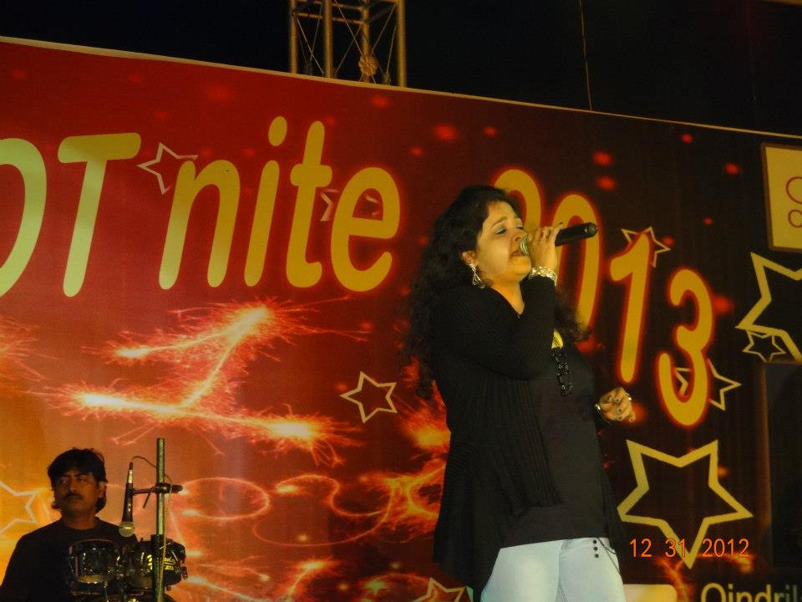

Slide 9
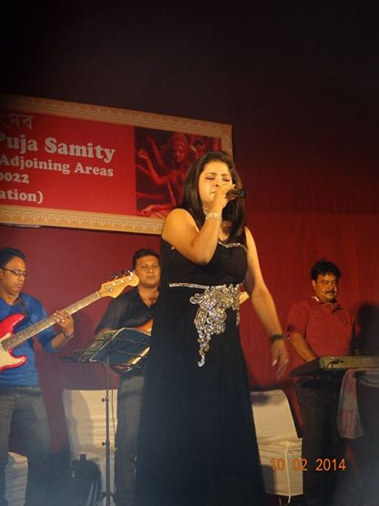
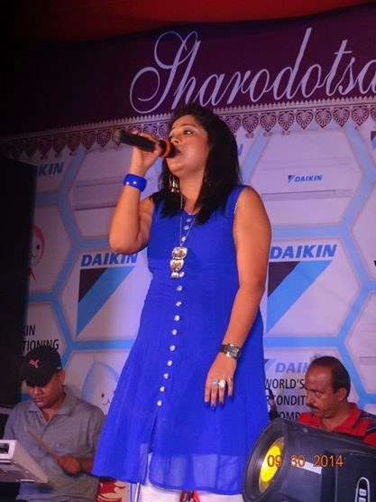

Slide 10
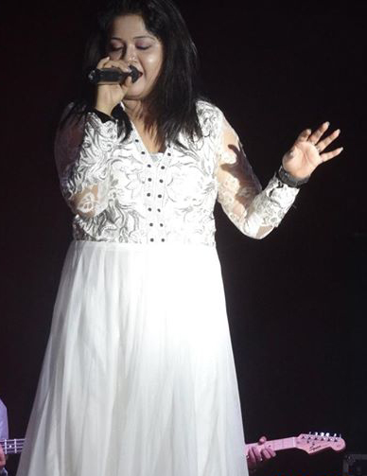
Thank You

